Slide 1
HEALTH INSURANCE CLAIM
PANCHAMI.P.M
MES20MCA-2038
PRODUCT OWNER-MS PRIYA JD

Slide 2
TABLE OF CONTENTS
Introduction
Modules
Data Flow Diagram
Table Design
Developing Environment
User Stories
Product Backlog
Project Plan
Sprint Plan
Sprint Backlog
Sprint Actual

Slide 3
INTRODUCTION
In this project a system and method for a rules-based pre-adjudication of a benefits claim submission is disclosed. The reviewing and adjudicating medical insurance claims is done electronically. In support medical procedure eligibility verification, data entry editing, electronic claim submission, claim status determination and electronic remittance processing is also done. The Medicare Claim helps us in creating the model for each registration and keeps tracking of claim management. It includes Main Modules like Admin, Health Provider, Insurance Company and Patients.
Insurance company processes the claim and updates the status for each claim. Advantage associated with the system is quicker claims processing and remittance, reduced transaction fees and direct connections with insurance companies.

Slide 4
MODULES
Admin
Health provider management.
Claim related complaint management.
Insurance company management.
Health Provider
Account creation.
Add Health care reports of patient (for claim. sanctioning purpose)
Add patient information.
Patient
Account creation.
Policy Selection.
Initiate claim request.
Document uploads.
View claim status.
Insurance Company
Registration.
Claim policy management.
Claim request management.
Health provider phr verification related to claim.
Claim patient document verification .
Sanctioning of claim.

Slide 5
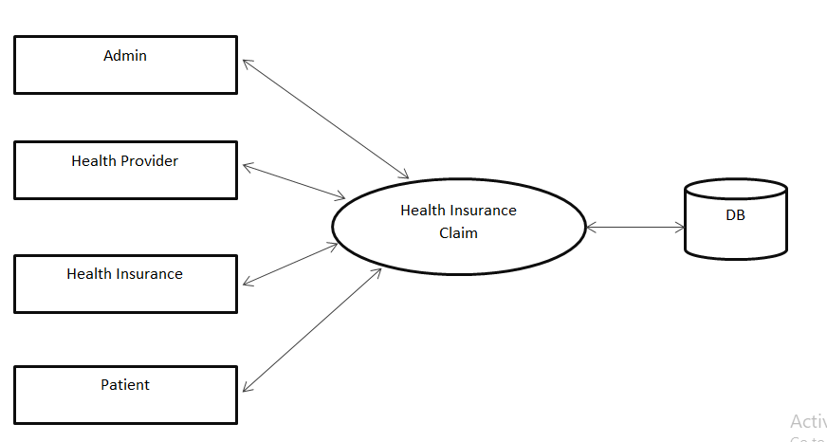
DFD
LEVEL-0

Slide 6
LEVEL-1
Login
Login
View HP request(A/R)
View accepted HP
Health provider
Admin
View rejected HP
IC request(A/R)
Insurance company
View accepted IC
Dealing of complaint(user)
Complaint

Slide 7
Registration
LEVEL-2
Health provider
.
Login
Login
Health Provider
Add patient information
View patient information
Patient
Add health care reports
View reports
Report

Slide 8
Signup
Patient
LEVEL-3
Login
Login
View policy
Policy
Patient
Select policy
Create claim request
Request
View claim request
Documents upload
Documents
View status of claim
Request

Slide 9
TABLE DESIGN
Complaint
Field_Name | Data type | Constraints
cid | Int | Primary key
Complaint_sender | Varchar
complaint | Varchar
date | Date
reply | Varchar
status | varchar
document
Field_Name | Data type | Constraints
did | int | Primary key
pid | Int
document | varchar
hplid | int

Slide 10
health_provider
Field_Name | Data type | Constraints
hpid | Int | Primary key
hp_name | Varchar
place | varchar
post | varchar
pin | Int
district | varchar
state | varchar
number | Int
Email | varchar
hplid | Int
status | varchar
website | varchar

Slide 11
insurance_company
Field_Name | Data type | Constraints
Icid | Int | Primary key
name | varchar
place | varchar
post | varchar
pin | Int
district | varchar
state | varchar
email | varchar
number | Int
website | varchar
status | varchar
iclid | int

Slide 12
login
Field_name | Data type | constraints
lid | Int | Primary key
username | varchar
password | varchar
type | varchar

Slide 13
patient
Field_name | Data type | Constraints
pid | Int | Primary key
name | varchar
place | varchar
post | varchar
pin | Int
district | varchar
state | varchar
number | bigint
dob | Int
gender | varchar
email | varchar
plid | int

Slide 14
policy
Field_name | Data type | Constraints
poid | Int | Primary key
po_name | varchar
amount | Int
description | varchar
rules | varchar
report
Field_name | Data type | Constraints
rid | Int | Primary key
plid | Int
report | Varchar
date | date

Slide 15
request
Field_name | Data type | constraints
rqid | int | Primary key
name | varchar
dob | varchar
gender | varchar
place | varchar
post | Varchar
pin | Int
district | varchar
state | varchar
number | Bigint
email | varchar
date | Date
policyid | Int

Slide 16
DEVELOPING ENVIRONMENT
Hardware Requirements
Input Device : Mouse, Keyboard
Output Device : Monitor
Memory : 4 Gb Ram(Minimum)
Processor : Intel core i3 or above
Software Requirements
Operating System : Windows 8 /10 for Better Performance
Front End : Python (Flask)
Back End : Mysql
Software Used : Pycharm
Web Browser :Internet Explorer/Google Chrome/Firefox(for web application)

Slide 17
USER STORIES
User Story ID | As a <type of user> | I want to | So that I can
1 | Admin | Health Provider Management | Health provider registration
2 | Admin | Insurance company Management | Verification of health insurance company
3 | Admin | Claim related complaint management | Dealing of complaint related to user claim and sent reply
4 | Health provider | Account creation | Account creation request sent to admin, admin verifies the request and sent confirmation via email
5 | Health provider | Add patient information | Management of his patients
6 | Health provider | Add Health care reports of patient (for claim sanctioning purpose) | Claim records uploads with detailed narration
7 | Insurance company | Registration | Account creation
8 | Insurance company | Claim policy management | Registration of different policies and its specification management
9 | Insurance company | Claim request management | Claim request management
10 | Insurance company | Health provider phr verification related to claim | Document verification
11 | Insurance company | Claim patient document verification | Verification of patient uploaded document with health provider report
12 | Insurance company | Sanctioning of claim | Claim sanctioning/ rejection/ adjustment of claim
13 | Patient | Account creation | Signup
14 | Patient | Policy Selection | View policy and select policy
15 | Patient | Initiate claim request | Create claim request
16 | Patient | Document uploads | Upload various documents related to claim
17 | Patient | View claim status | View status of request

Slide 18
PRODUCT BACKLOG
User Story ID | Priority <High/Medium/Low> | Size (Hours) | Sprint <#> | Status <Planned/In progress/Completed> | Release Date | Release Goal
1 | High | 4 | 1 | Completed | 05/12/2021 | Health provider registration
2 | Medium | 2 |  | Completed | 18/12/2021 | Account creation
3 | High | 4 |  | Completed | 25/12/2021 | Registration

Slide 19
4 | High | 4 | 2 | Planned | 30/12/2021 | Claim policy management
5 | Medium | 2 |  | Planned | 09/01/2022 | Account creation
6 | Medium | 3 |  | Planned | 18/01/2022 | Policy Selection
7 | High | 4 |  | Planned | 28/01/2022 | Initiate claim request

Slide 20
8 | Medium | 3 | 3 | Planned | 30/01/2022 | Add patient information
9 | Medium | 3 |  | Planned | 31/01/2022 | Add Health care reports of patient (for claim sanctioning purpose
10 | Medium | 2 |  | Planned | 02/02/2022 | Claim request management
11 | High | 4 |  | Planned | 04/02/2022 | Health provider phr verification related to claim

Slide 21
12 | Medium | 2 | 4 | Planned | 06/02/2022 | Insurance company Management
13 | Medium | 2 |  | Planned | 08/02/2022 | Claim related complaint management
14 | High | 4 |  | Planned | 12/02/2022 | Claim patient document verification
15 | Medium | 3 |  | Planned | 15/02/2022 | Sanctioning of claim
16 | Medium | 2 |  | Planned | 17/02/2022 | Document uploads
17 | Medium | 2 |  | Planned | 20/02/2022 | View claim status

Slide 22
PROJECT PLAN
User story ID | Task name | Start date | End date | Hours | Status
1 | Sprint1 | 01/12/2021 | 05/12/2021 | 10 | Completed
4 |  | 08/12/2021 | 18/12/2021 |  | Completed
7 |  | 22/12/2021 | 25/12/2021 |  | Completed

Slide 23
8 | Sprint 2 | 28/12/2021 | 30/12/2021 | 13 | In progress
13 |  | 05/01/2022 | 09/01/2022 |  | In progress
14 |  | 12/01/2022 | 18/01/2022 |  | In progress
15 |  | 22/01/2022 | 28/01/2022 |  | In progress

Slide 24
User story ID | Task name | Start date | End date | Hours | Status
Sprint3
5 | Sprint 3 | 29/01/2022 | 30/01/2022 | 12 | In progress
6 |  | 30/01/2022 | 31/01/2022 |  | In progress
9 |  | 03/02/2022 | 02/02/2022 |  | In progress
10 |  | 12/02/2022 | 04/02/2022 |  | In progress

Slide 25
Sprint4
2 | Sprint 4 | 05/02/2022 | 06/02/2022 | 15 | In progress
3 |  | 07/02/2022 | 08/02/2022 |  | In progress
11 |  | 09/02/2022 | 12/02/2022 |  | In progress
12 |  | 13/02/2022 | 15/02/2022 |  | In progress
16 |  | 16/02/2022 | 17/02/2022 |  | In progress
17 |  | 18/02/2022 | 20/02/2022 |  | In progress

Slide 26
SPRINT BACKLOG PLAN-Sprint1
Backlog Item | Status & completion date | Original estimate in hours | Day1 | Day2 | Day3 | Day4 | Day5 | Day6 | Day7 | Day8 | Day9 | Day10 | Day11 | Day12 | Day13 | Day14
User story #1,4,7 |  | hrs | hrs | hrs | hrs | hrs | hrs | hrs | hrs | hrs | hrs | hrs | hrs | hrs | hrs | hrs
UI designing | 05/12/2021 | 3 | 1 | 1 | 1 | 0 | 0 | 0 | 0 | 0 | 0 | 0 | 0 | 0 | 0 | 0
Database connectivity | 18/12/2021 | 2 | 1 | 1 | 0 | 0 | 0 | 0 | 0 | 0 | 0 | 0 | 0 | 0 | 0 | 0
Coding | 25/12/2021 | 5 | 1 | 0 | 2 | 1 | 0 | 0 | 0 | 1 | 0 | 0 | 0 | 0 | 0 | 0
Total |  | 10 | 3 | 2 | 3 | 1 | 0 | 0 | 0 | 1 | 0 | 0 | 0 | 0 | 0 | 0

Slide 27
SPRINT ACTUAL-Sprint1
Backlog Item | Status & completion date | Original estimate in hours | Day1 2/3 | Day2 3/3 | Day3 4/3 | Day4 5/3 | Day5 6/3 | Day6 7/3 | Day7 8/3 | Day8 9/3 | Day9 10/3 | Day10 11/3 | Day11 12/3 | Day12 13/3 | Day13 14/3 | Day14 15/3 | Completed(Y/N)
User story #1,4,7 |  | hrs | hrs | hrs | hrs | hrs | hrs | hrs | hrs | hrs | hrs | hrs | hrs | hrs | hrs | hrs
UI designing | 05/12/2021 | 3 | 1 | 1 | 1 | 0 | 0 | 0 | 0 | 0 | 0 | 0 | 0 | 0 | 0 | 0 | Y
Database connectivity | 18/12/2021 | 2 | 1 | 1 | 0 | 0 | 0 | 0 | 0 | 0 | 0 | 0 | 0 | 0 | 0 | 0 | Y
Coding | 25/12/2021 | 5 | 1 | 0 | 2 | 1 | 0 | 0 | 0 | 1 | 0 | 0 | 0 | 0 | 0 | 0 | Y
Total |  | 10 | 3 | 2 | 3 | 1 | 0 | 0 | 0 | 1 | 0 | 0 | 0 | 0 | 0 | 0 | 0

Slide 28
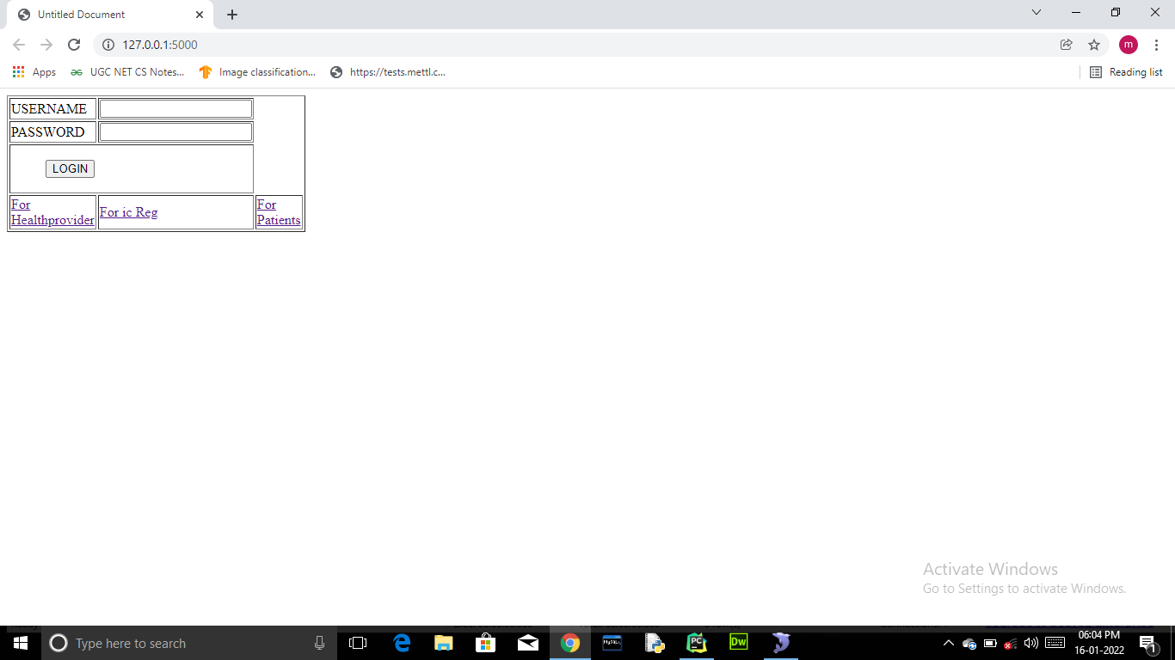

Slide 29
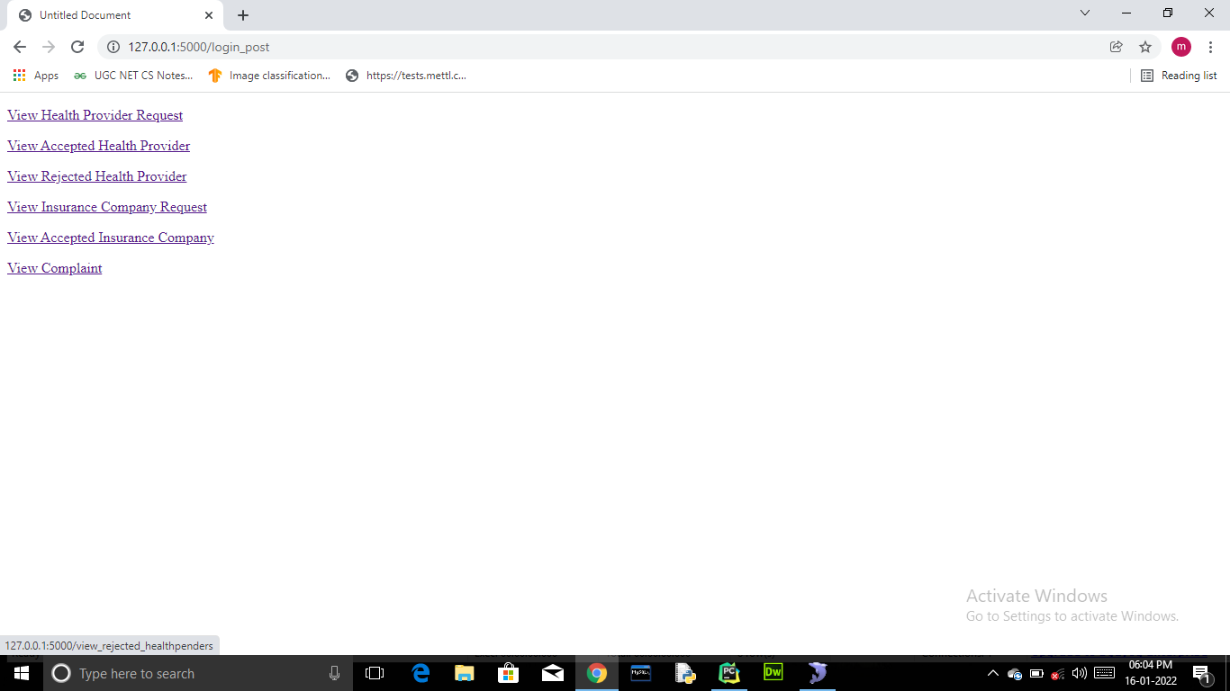

Slide 30
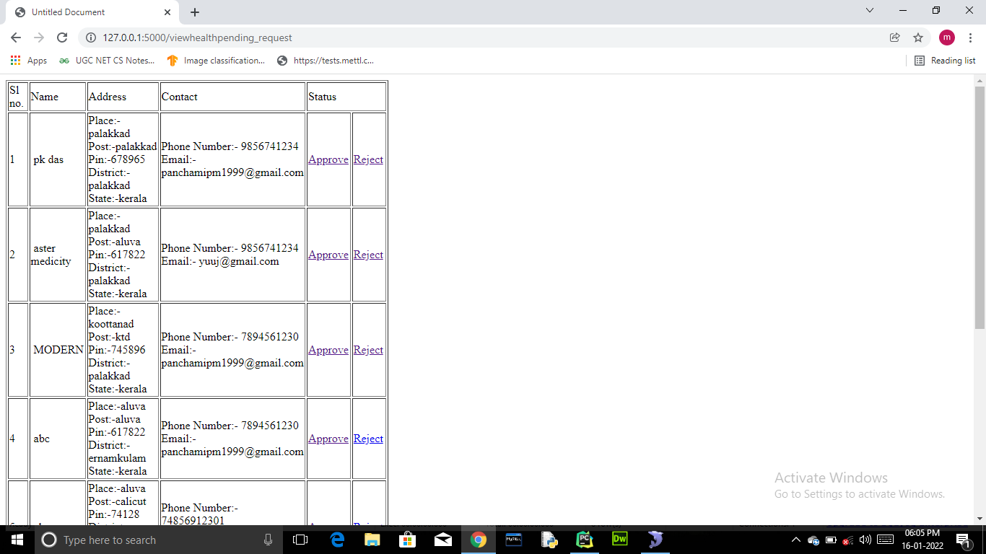

Slide 32
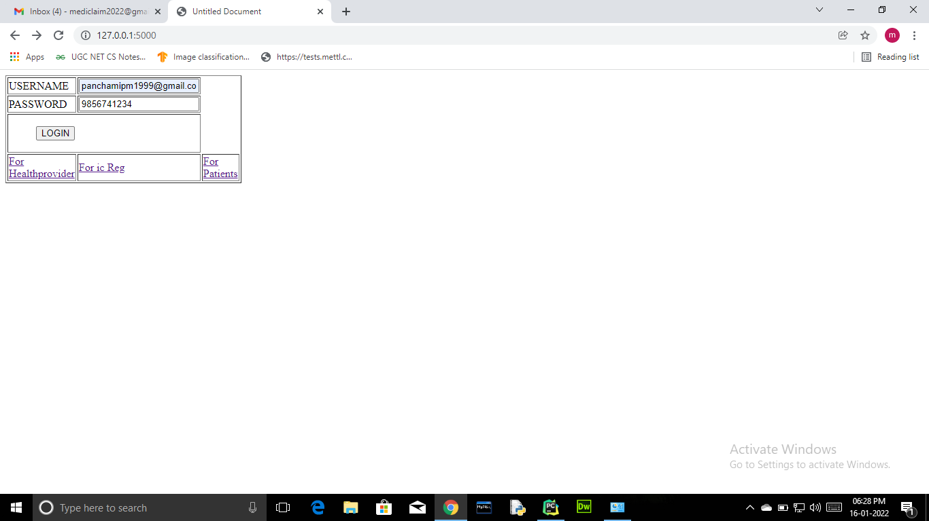

Slide 33
